Slide 1
MARTe Multi-Platform Real-Time executor
A. Neto, February 2013

Slide 2

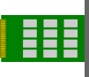
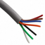
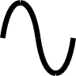

MARTe?
Multi-platform C++ real-time control middleware
Simulink-like way of describing the problem
Modular development and execution environment for control systems
Ensures and monitors real-time
Facilitates test & commissioning

Slide 3

Main features
Modular
Clear boundary between algorithms, hardware interaction and system configuration
Reusability and maintainability
Simulation
Agnostic of the operational environment
Different profiles of people can develop in parallel
Interfaces to hardware
Algorithms
Interfaces to CODAC
Develop and test in different platforms
Deploy the same source

Slide 4




Modularity (GAMs)
Define boundaries
Algorithms and hardware don't mix!
Modules do only what they advertise
No interdependence or a priori knowledge
Generic by design
Same goals, same module
Reusability and maintainability
Simulation
Replace actuators and plants with models
Keep all the other modules untouched
Hardware
Models
Persistence
Algorithms
Debug
Decision
Scheduling
Information

Slide 5
Dynamic Data Buffer (DDB)
GAMs share data through a memory bus
MARTe guarantees coherency between requested and produced signals
Set of GAMs allow to stream data to different MARTe systems
Distributed control systems

Slide 6
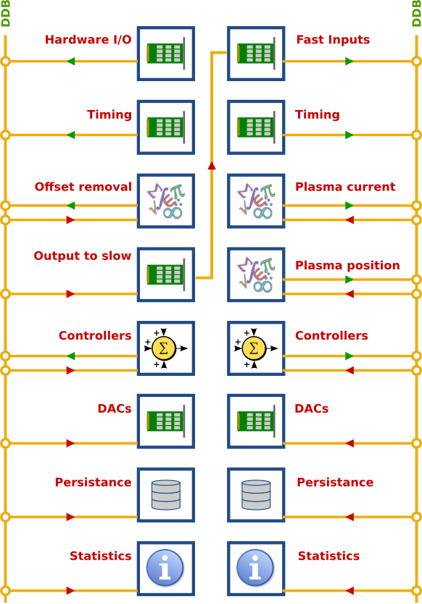
Real-Time Threads
Sequentially execute GAMs
Work as micro-schedulers
Can be allocated to specific CPUs
Keep accurate information about execution times
Require an external time and triggering mechanism
Multiple RTThreads can run in parallel
Synchronously or asynchronously

Slide 7
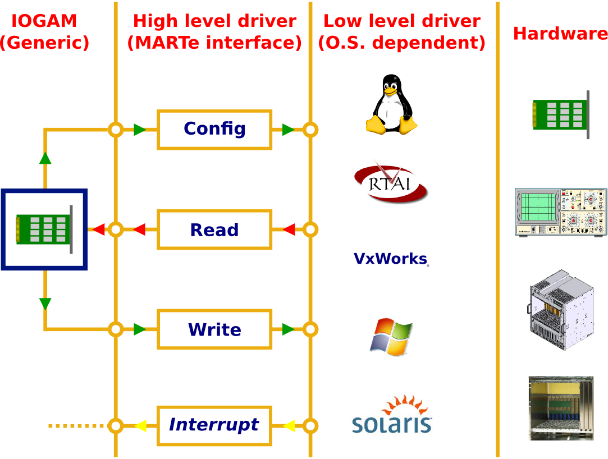
IOGAM
Interface between GAMs and outside world
Bridge data into/from DDB signals
Using MARTe high level drivers
Connect to hardware
ADCs
DACs
DIOs
Networks
Filesystems
…

Slide 8
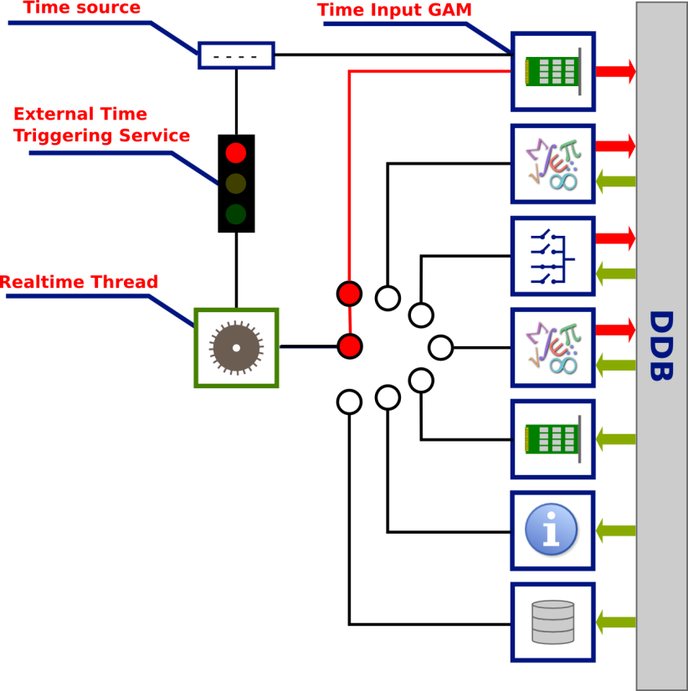




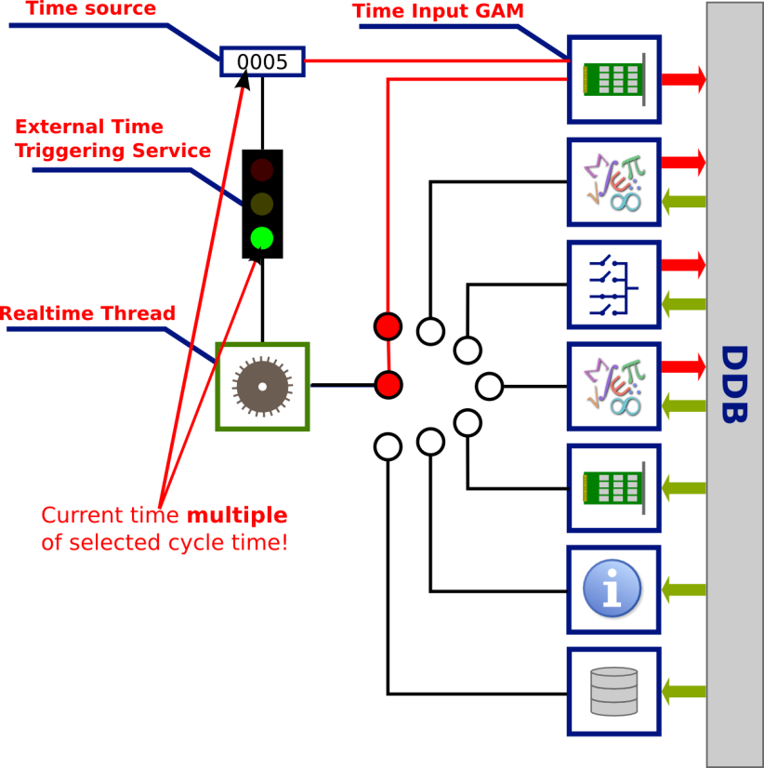
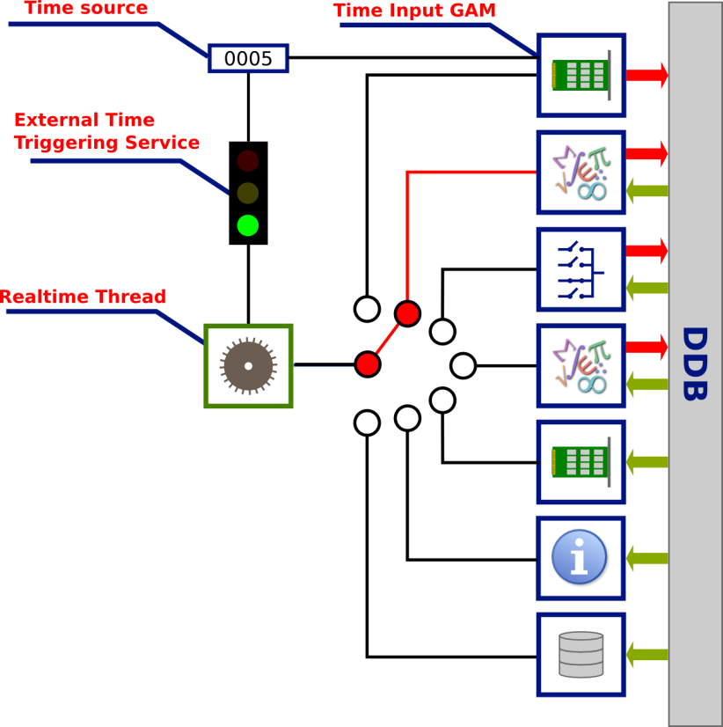
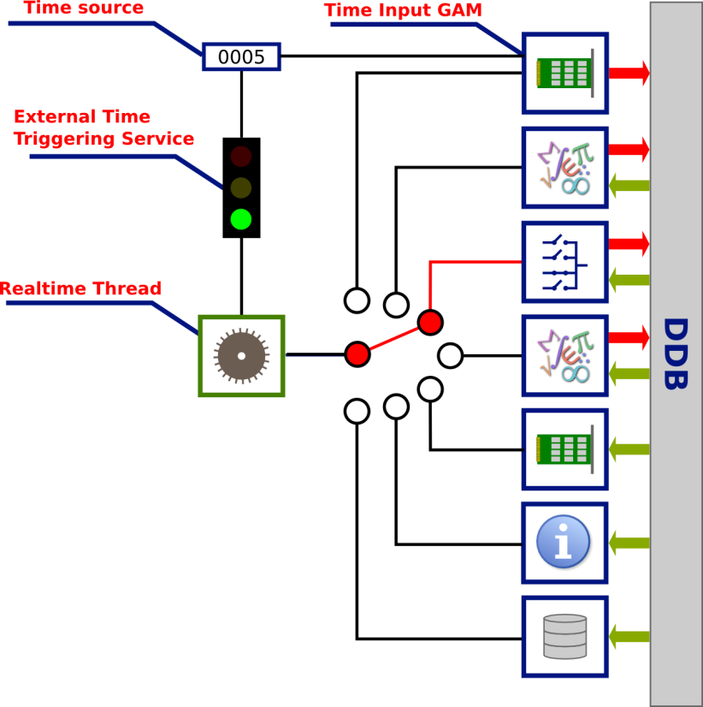
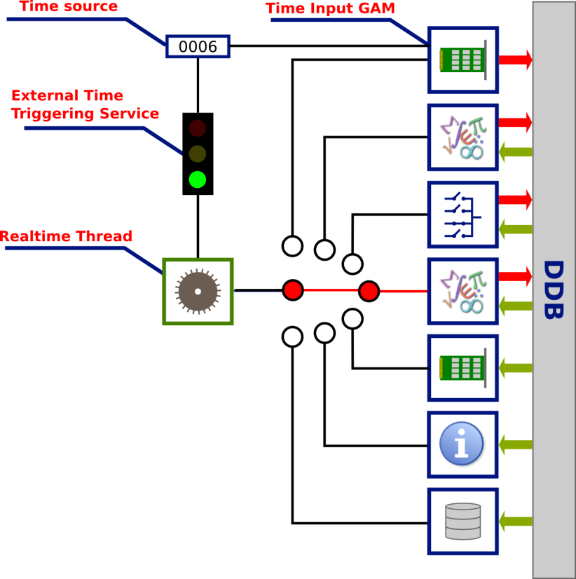

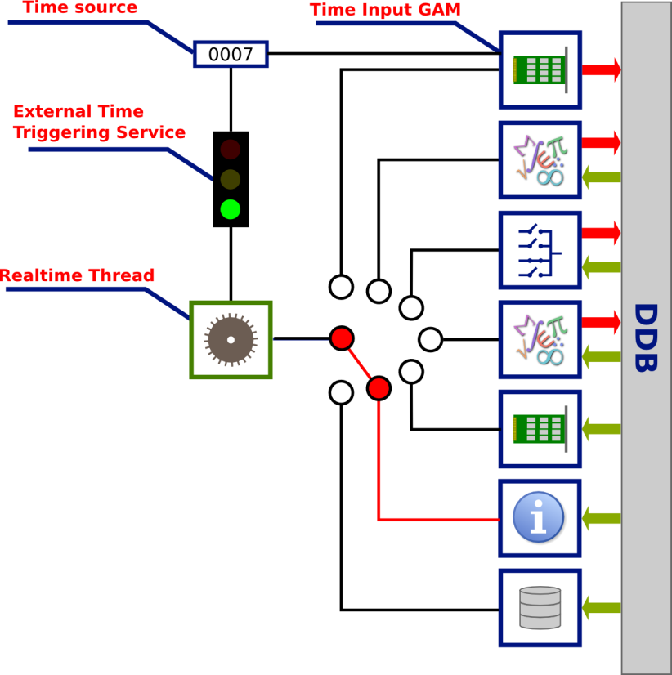
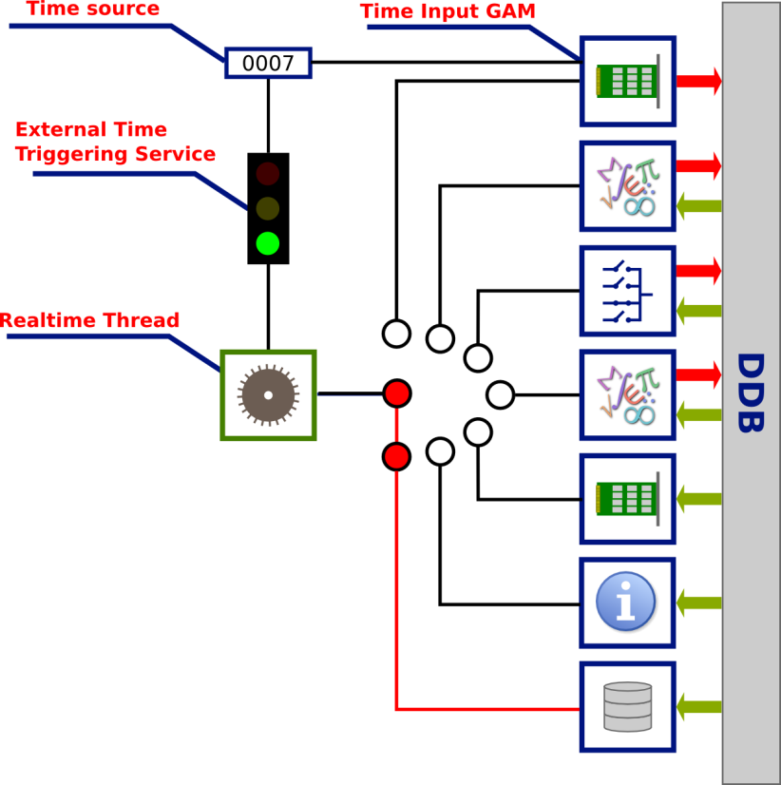
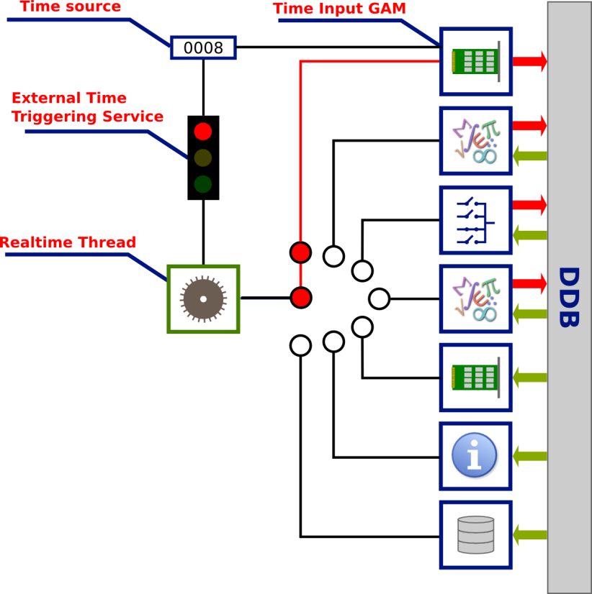





External Time Triggering Service
Responsible to trigger a control cycle
One per real-time thread
Driven by an external entity
Clock
ADC
Network
Time vector from experimental data
Repeat past experiments

Slide 9
Data driven components (MARTe language)
Structured syntax
Defines common language
Simple
Human readable configuration
Provides built-in validation
Allows for a clear way of expressing the problem
Similar to XML
Classes are automatically instantiated
Configuration is validated by the created object
Asserting and parsing functions available
+HttpServer = {
Class = HttpService
Port = 8084
}
...
+Control = {
Class = ControlGAM
Controller = {
NoPlasmaVelocityGain = 0.0
NoPlasmaCurrentGain = 40.0
IPWaveform = {
Times = {0 120}
Amplitudes = {0.5 0.5}
Rounding = 50
}
...

Slide 10
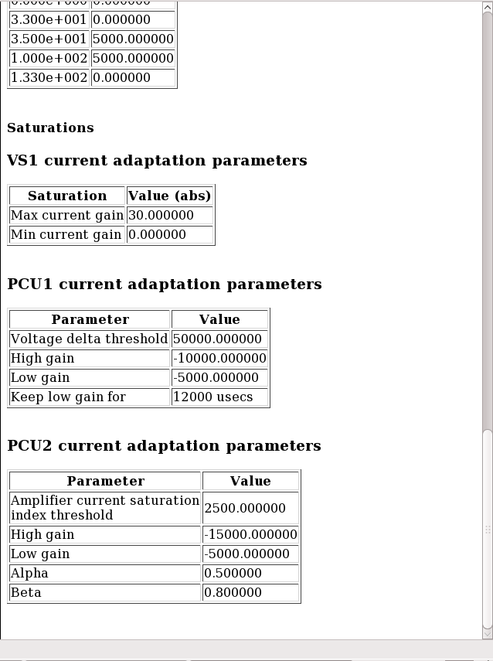
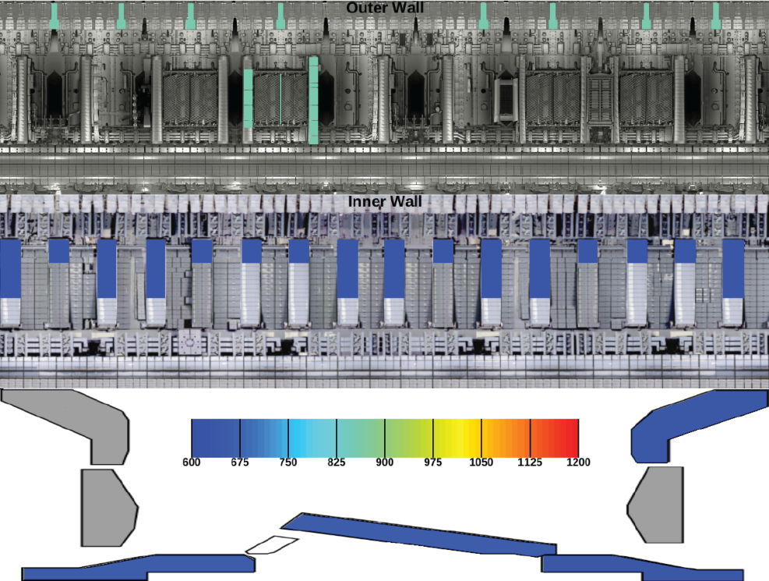
Live Introspection
Probe the system
Without sacrificing RT
Crucial for an expedite debugging
GAM from protection system at JET
Automatically built

Slide 11
MARTe components
MARTe
RTThread 1
State machine
GAM 1
DDB
GAM N
GAM 2
Driver pool
RTThread N
GAM 1
DDB
External time
triggering services
GAM N
GAM 2

Slide 12
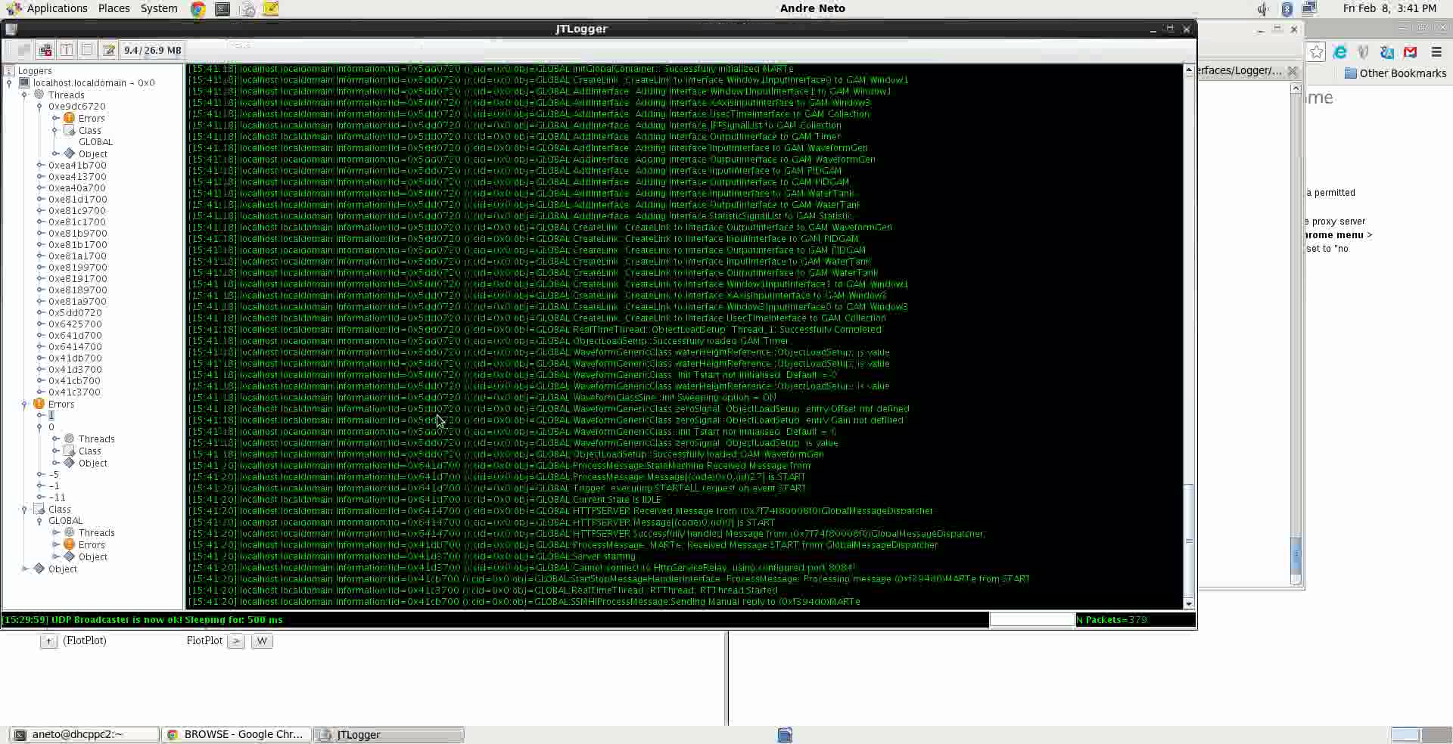
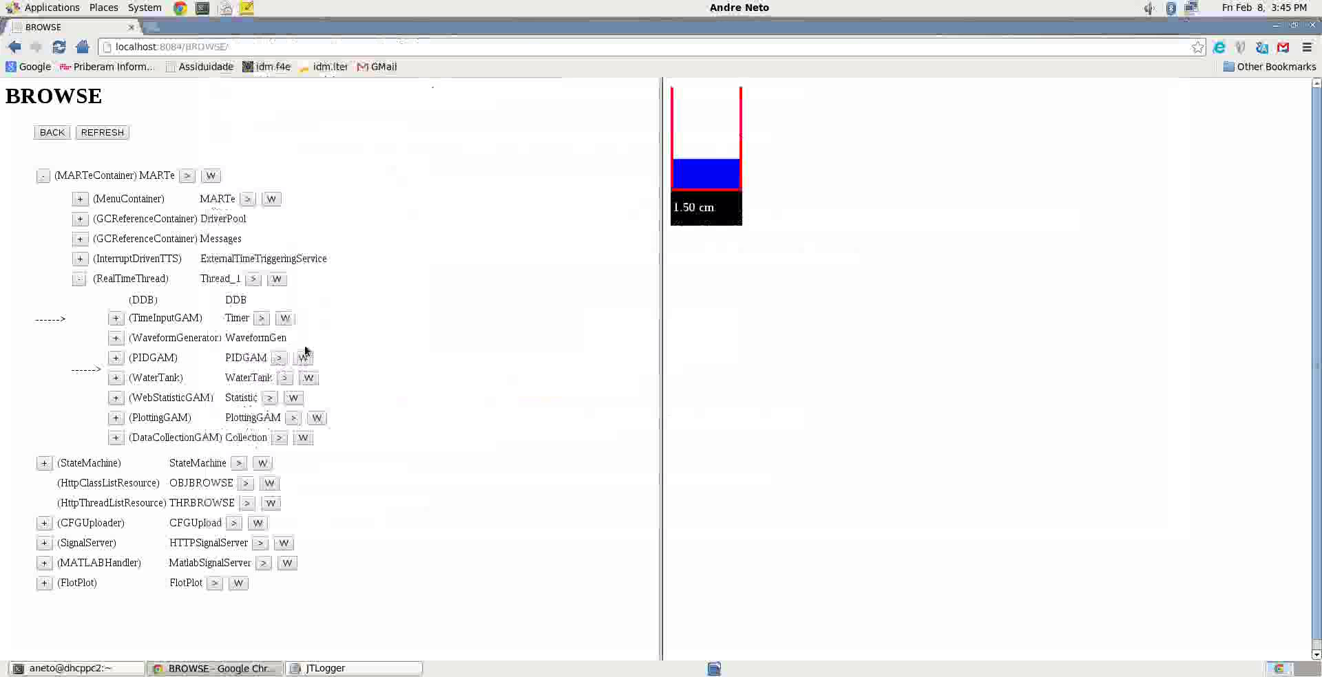
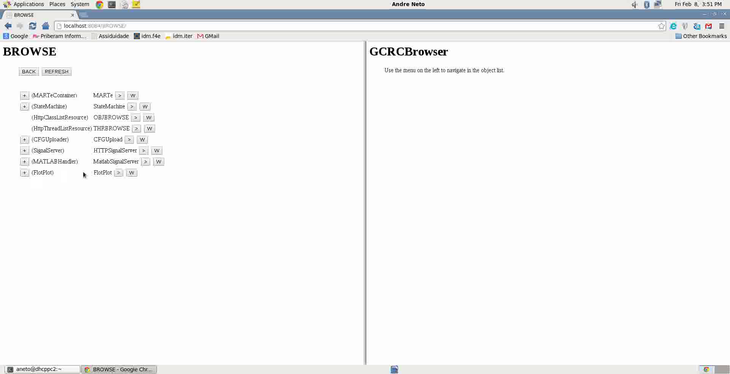
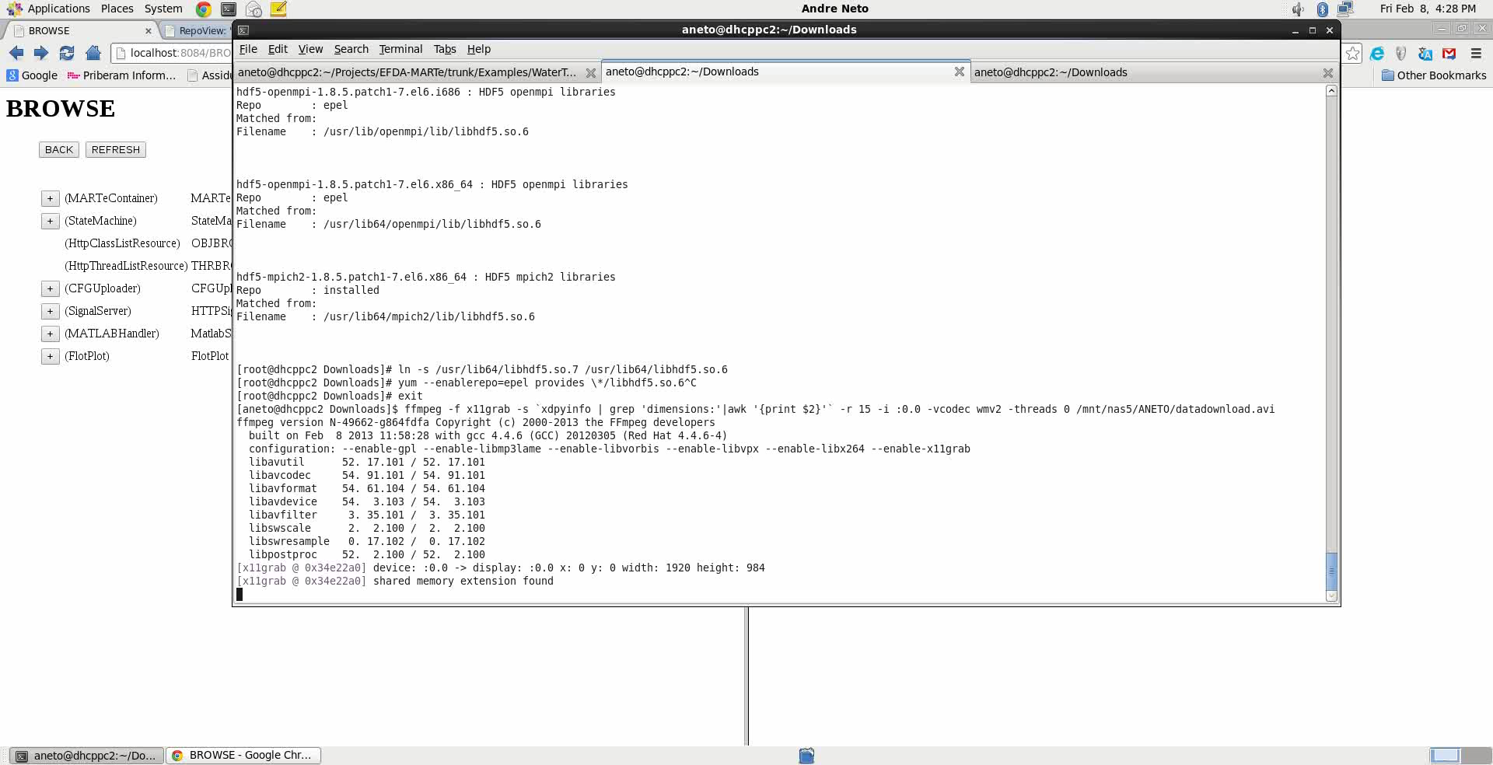
Interfacing with MARTe
State machine
Logger Server
HTTP Server
MARTe
Any other
Object N
Configuration
provider
Data retrieval
facility

Slide 13
Where is MARTe being used
JET
Vertical Stability
COMPASS
Shape control
Real-time Protection Sequencer
Vessel Thermal map
Equinox
Walls
Beta-Li
As part of post-processing codes
Vertical Stability
ISTTOK
Integrated plasma control
FTU
Integrated plasma control
Additional heating control
KSTAR
*Density control
RFX
Performance studies of the framework

Slide 14
Why I believe MARTe is a good framework
Allows different type of users to work together
…at the same time…
…in the same project…
Drive people to focus on what they know best
GAMs
Modelers
Physicists
Control engineers
Software engineers
IOGAMs/High level drivers
Control engineers
Software engineers
Interfaces
Software engineers

Slide 15
Why I believe MARTe is a good framework
Truly reusable
The same framework can run in the office and in the real-time environment
No code changes
Portable
Can run anywhere without any specific dependences
No dependencies on external libraries
That are not controlled by the community
Simple hardware interface concept
The IOGAM/high level driver enables to very easily change the input data source(s) and the output data sink(s)
Commission friendly
Easily broken into smaller pieces…
…that might be part of a bigger orchestra…

